Slide 1
Checkers Game
Spandana Janga
Naga Poojitha Konda

Slide 2
Outline
Abstract
Objective
Introduction
AI- Perspective
Results
Conclusion

Slide 3
Abstract
This presentation provides an overview of classic two-player board game , checkers also known as draughts . It covers the basic rules , game play objectives and strategic concepts employed by skilled players. Different variants of checkers will be discussed highlighting their unique challenges.

Slide 4
Objective
The main Objective of this project was to create the checkers game environment among Humans vs AI and AI vs AI by using alpha beta pruning, mini-max algorithms and Q-learning algorithms.

Slide 5
Introduction
On an 8x8 board with the alternating shaded squares checkers is played. On the dark squares closest to them each player starts with 12 checkers.
The objective of the game is to either capture all of your opponent pieces or block them so they can’t make any legal moves.
In this project Human vs AI game play is defined and alpha beta pruning game play is defined and whole environment was set to an interesting game
It is also having AI vs AI gameplay and defined by policy optimization.

Slide 6
Alpha Beta Pruning
A method called alpha beta pruning is used in conjunction with the mini-max algorithm to minimize the total number of nodes that require assessment. Alpha & beta which stands for the greatest possible scores for the maximizing player (alpha) and minimizing player(beta). The algorithm modifies variables as the search goes on & removes game tree branches that are known to be unimportant for the outcome.

Slide 7
Mini-max Algorithm
In order to calculate the optimal move game playing systems frequently employ the mini max algorithm. It switches between lowering the opponents score(MIN) and increasing the computer players score(MAX).

Slide 8
Q Learning Algorithm
The best action-selection strategy for a particular Markov decision process (MDP) may be found using the reinforcement learning approach known as Q-learning.
Q-learning’s primary objective is to learn a policy that instructs an agent on what to do in certain situations in order to maximize cumulative rewards over time.
Since Q-learning is model-free, it doesn't need a model of the dynamics of the environment; instead, it learns from interactions with the environment directly.
The predicted cumulative reward for carrying out a certain action in a specific state is represented by the Q-value function, which is learned by Q-learning.

Slide 9
AI- Perspective – How to win the game
Control the center
Playing defense won’t win the game.
Your goal should be getting a checker to the end of board.
Be willing to sacrifice a checker if necessary.
Finally remember the blocking option.

Slide 10
Code Demonstration

Slide 11
Execution and Evaluation

Slide 12
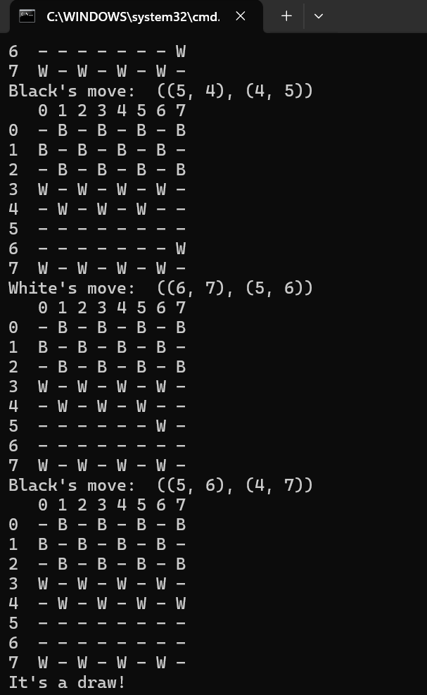
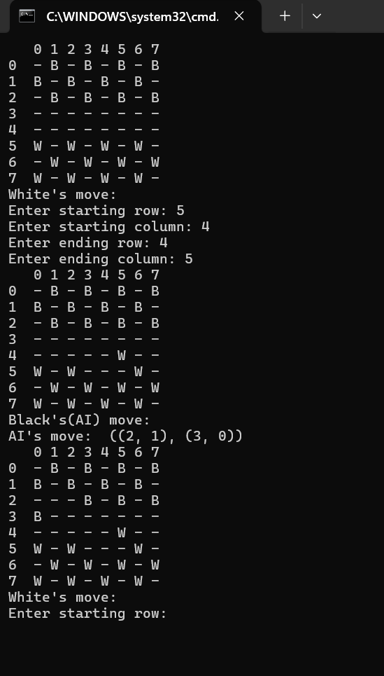
Results
Upon the execution of code, the output is as follows for AI VS AI and Human VS AI
1. OUTPUT FOR AI VS AI 2. OUTPUT FOR Human VS AI

Slide 13
Conclusion
Finally, the given python code provides a basic structure for developing and using the checkers game. It consists of fundamental elements such as player agents, game logic.
This project can be further modelized to compare the Q-Learning agent with other model free reinforcement agents.

Slide 14
THANK YOU

